Slide 1

Data Types and Operators
Variables, Data Types & Arithmetic Operators
Produced
by:
Department of Computing and Mathematics

Slide 2
Topics list
Variables.
Assignment statement.
Data Types.
Java’s Primitive Data Types
Whole numbers.
Decimal numbers.
Others.
Arithmetic operators.

Slide 3
Variables
In Programming, variables:
are created (defined) in your programs.
are used to store data (whose value can change over time).
have a data type.
have a name.
are a VERY important programming concept.

Slide 4
Variable names…
Are case-sensitive.
Begin with either:
a letter (preferable),
the dollar sign "$", or
the underscore character "_".
Can contain letters, digits, dollar signs, or underscore characters.
Can be any length you choose.
Must not be a keyword or reserved word e.g. int, while, etc.
Cannot contain white spaces (i.e. space bar value).
https://docs.oracle.com/javase/tutorial/java/nutsandbolts/variables.html

Slide 5
Variable names should be carefully chosen
Use full words instead of cryptic abbreviations e.g.
variables named speed and gear are much more intuitive than abbreviated versions, such as s and g.
If the name consists of:
only one word, spell that word in all lowercase letters e.g. ratio.
more than one word, capitalise the first letter of each subsequent word e.g. gearRatio and currentGear.
https://docs.oracle.com/javase/tutorial/java/nutsandbolts/variables.html

Slide 6
Topics list
Variables.
Assignment statement.
Data Types.
Java’s Primitive Data Types
Whole numbers.
Decimal numbers.
Others.
Arithmetic operators.

Slide 7
Assignment Statement
Values are stored in variables via assignment statements:
A variable stores a single value, so any previous value is lost.
Assignment statements work by taking the value of what appears on the right-hand side of the operator and copying that value into a variable on the left-hand side.
Syntax | variable = expression;
Example | numberOfItems = 100;

Slide 8
Topics list
Variables.
Assignment statement.
Data Types.
Java’s Primitive Data Types
Whole numbers.
Decimal numbers.
Others.
Arithmetic operators.

Slide 9
Data Types
In Java, when we define a variable, we have to give it a data type.
The data type defines the kinds of values (data) that can be stored in the variable e.g.
- 456
2
45.7897
I Love Programming
S
true
The data type also determines the operations that may be performed on it.

Slide 10
Data Types
Java uses two kinds of data types:
Primitive types
Object types
We are going to look at Primitive types now.

Slide 11
Topics list
Variables.
Assignment statement.
Data Types.
Java’s Primitive Data Types
Whole numbers.
Decimal numbers.
Others.
Arithmetic operators.

Slide 12
Java’s Primitive Data Types
Java programming language has eight primitive data types.
A primitive type is predefined by the language and is named by a reserved keyword.
A primitive type is highlighted red when it is typed into the PDE e.g.
int a;
boolean flag;
float number;

Slide 13
Topics list
Variables.
Assignment statement.
Data Types.
Java’s Primitive Data Types
Whole numbers.
Decimal numbers.
Others.
Arithmetic operators.

Slide 14
Java’s Primitive Data Types (whole numbers)
Type | Byte-size | Minimum value (inclusive) | Maximum value (inclusive) | Typical Use
byte | 8-bit | -128 | 127 | Useful in applications where memory savings apply.
short | 16-bit | -32,768 | 32,767
int | 32-bit | -2,147,483,648 | 2,147,483,647 | Default choice.
long | 64-bit | -9,223,372,036,854,775,808 | 9,223,372,036,854,775,807 | Used when you need a data type with a range of values larger than that provided by int.

Slide 15
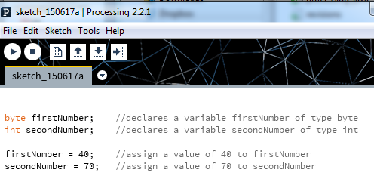
Declaring variables of a specific type
Notes:
byte firstNumber; //declares a variable firstNumber of type byte
int secondNumber; //declares a variable secondNumber of type int
firstNumber = 40; //assign a value of 40 to firstNumber
secondNumber = 70; //assign a value of 70 to secondNumber

Slide 16
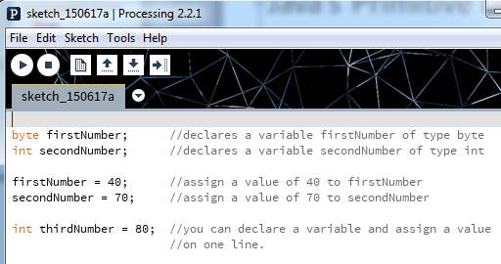
Declaring variables of a specific type
Notes:
byte firstNumber; //declares a variable firstNumber of type byte
int secondNumber; //declares a variable secondNumber of type int
firstNumber = 40; //assign a value of 40 to firstNumber
secondNumber = 70; //assign a value of 70 to secondNumber
int thirdNumber = 80; //you can declare a variable and assign a value
//on one line.

Slide 17
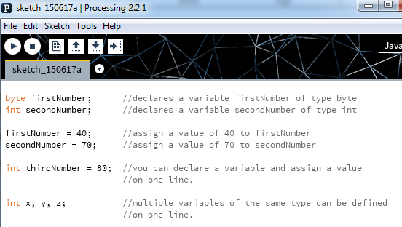
Declaring variables of a specific type
Notes:
byte firstNumber; //declares a variable firstNumber of type byte
int secondNumber; //declares a variable secondNumber of type int
firstNumber = 40; //assign a value of 40 to firstNumber
secondNumber = 70; //assign a value of 70 to secondNumber
int thirdNumber = 80; //you can declare a variable and assign a value
//on one line.
int x, y, z; //multiple variables of the same type can be defined
//on one line.

Slide 18
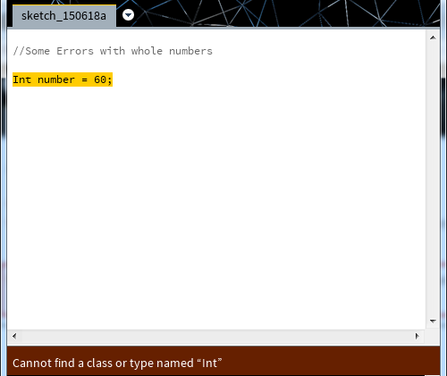
Declaring variables - some errors
Data types are case sensitive.
Int is not valid.
int is valid.
Notes:
int number = 60;
int number = 56;
int anotherNumber = 58.98;

Slide 19
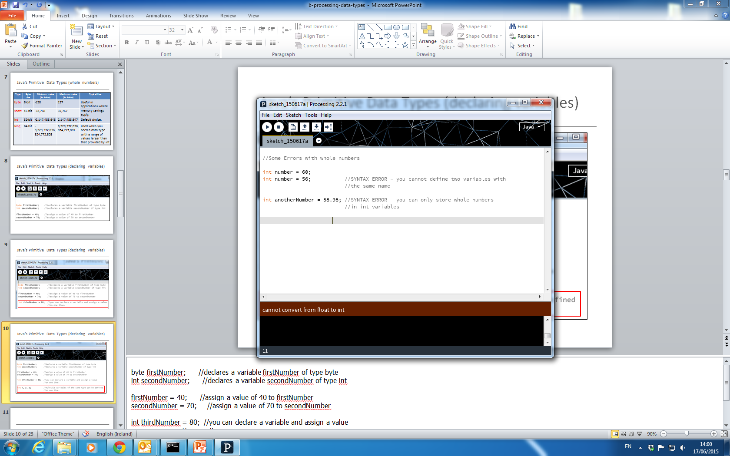
Declaring variables - some errors
Notes:
int number = 60;
int number = 56;
int anotherNumber = 58.98;

Slide 20
Declaring variables - some errors

Slide 21
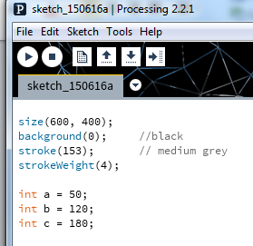
Java’s Primitive Data Types: int Example 3.1
In this example, we have:
defined three variables (a, b and c)
that can hold whole numbers (int).
and are set with a starting value.
Based on the Processing Example: Basics → Data → Variables

Slide 22
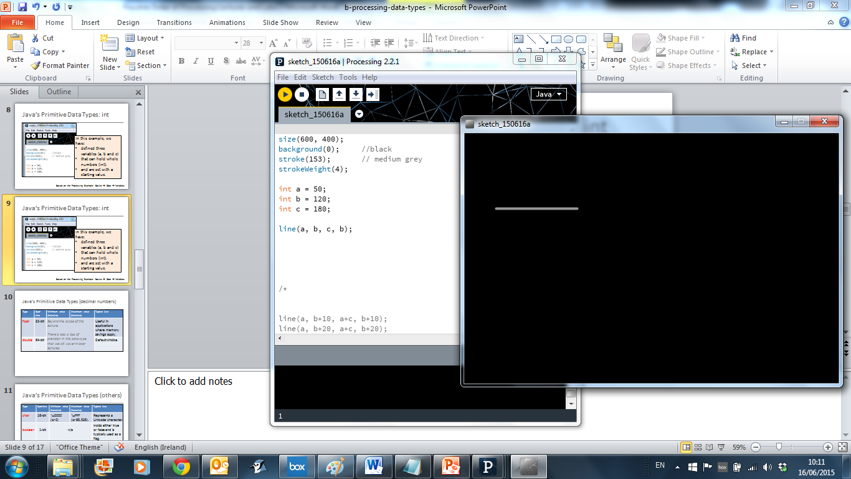
Java’s Primitive Data Types: int Example 3.2
We can pass the defined variables as values to functions.
Based on the Processing Example: Basics → Data → Variables

Slide 23
Java’s Primitive Data Types: int Example 3.3
Could we have used the byte data type instead of int? Why?
Type | Minimum value (inclusive) | Maximum value (inclusive)
byte | -128 | 127
short | -32,768 | 32,767
int | -2,147,483,648 | 2,147,483,647
long | -9,223,372,036,854,775,808 | 9,223,372,036,854,775,807
Based on the Processing Example: Basics → Data → Variables

Slide 24
Topics list
Variables.
Assignment statement.
Data Types.
Java’s Primitive Data Types
Whole numbers.
Decimal numbers.
Others.
Arithmetic operators.

Slide 25
Java’s Primitive Data Types (decimal numbers)
Type | Byte-size | Minimum value (inclusive) | Maximum value (inclusive) | Typical Use
float | 32-bit | Beyond the scope of this course. |  | Useful in applications where memory savings apply. Default choice when using Processing.
double | 64-bit |  |  | Default choice when programming Java apps.

Slide 26
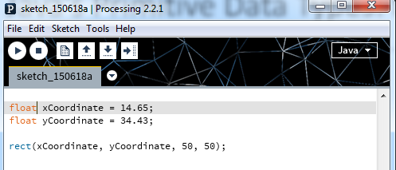
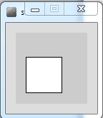
Java’s Primitive Data Types: float Example 3.4
We can pass the defined variables as values to functions.

Slide 27
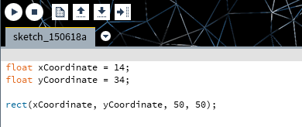
Java’s Primitive Data Types: float Example 3.5
Whole numbers can be placed into a float variable.
Q: Why?
A: There is no loss of precision. We are not loosing any data.

Slide 28
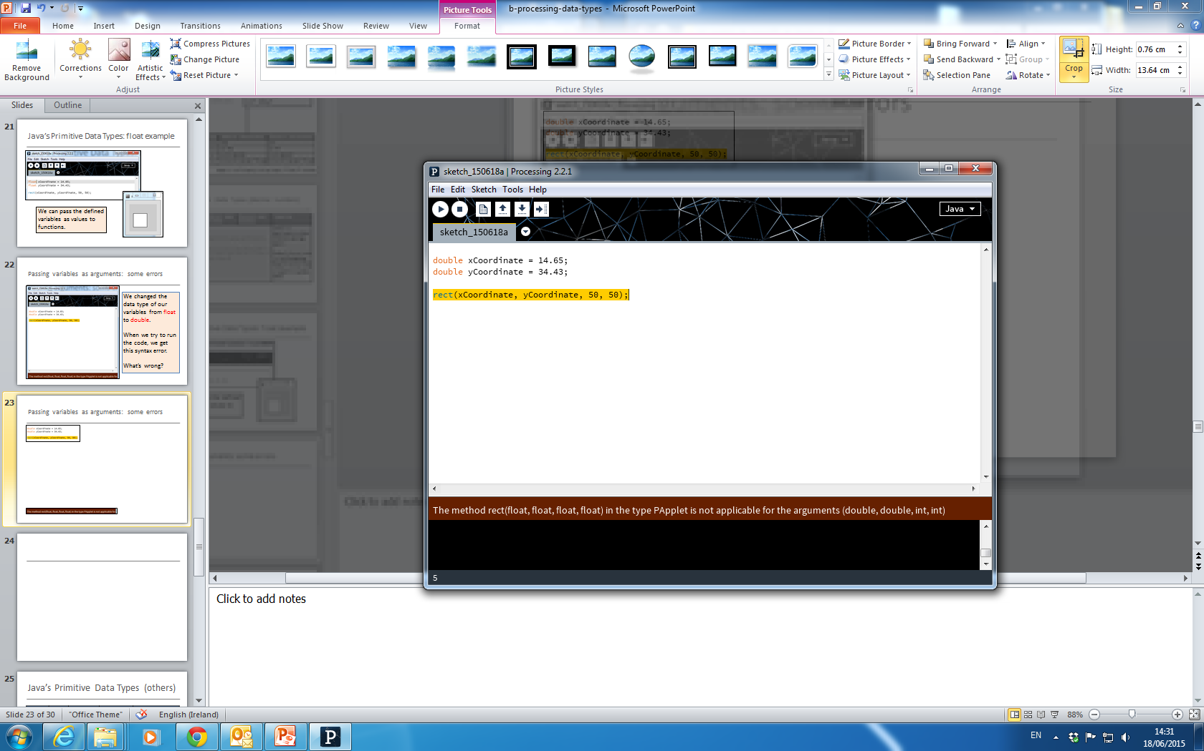
Passing variables as arguments: some errors
We changed the data type of our variables from float to double.
When we try to run the code, we get this syntax error.
What’s wrong?

Slide 29
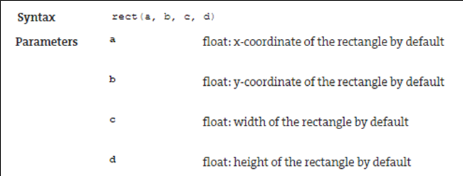
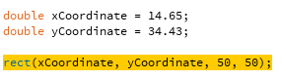
Passing variables as arguments: some errors
From: https://processing.org/reference/rect_.html

Slide 30
Topics list
Variables.
Assignment statement.
Data Types.
Java’s Primitive Data Types
Whole numbers.
Decimal numbers.
Others.
Arithmetic operators.

Slide 31
Java’s Primitive Data Types (others)
We will go into more detail on these two data types later in the course.
Type | Byte-size | Minimum value (inclusive) | Maximum value (inclusive) | Typical Use
char | 16-bit | '\u0000' (or 0) | '\uffff' (or 65,535). | Represents a Unicode character.
boolean | 1-bit | n/a |  | Holds either true or false and is typically used as a flag.
http://en.wikipedia.org/wiki/List_of_Unicode_characters

Slide 32
Java’s Primitive Data Types (default values)
Data Type | Default Value
byte | 0
short | 0
int | 0
long | 0L
float | 0.0f
double | 0.0d
char | '\u0000'
boolean | false
http://docs.oracle.com/javase/tutorial/java/nutsandbolts/datatypes.html

Slide 33
Topics list
Variables.
Assignment statement.
Data Types.
Java’s Primitive Data Types
Whole numbers.
Decimal numbers.
Others.
Arithmetic operators.

Slide 34
Arithmetic Operators
Arithmetic Operator | Explanation | Example(s)
+ | Addition | 6 + 2 amountOwed + 10
- | Subtraction | 6 – 2 amountOwed – 10
* | Multiplication | 6 * 2 amountOwed * 10
/ | Division | 6 / 2 amountOwed / 10

Slide 35
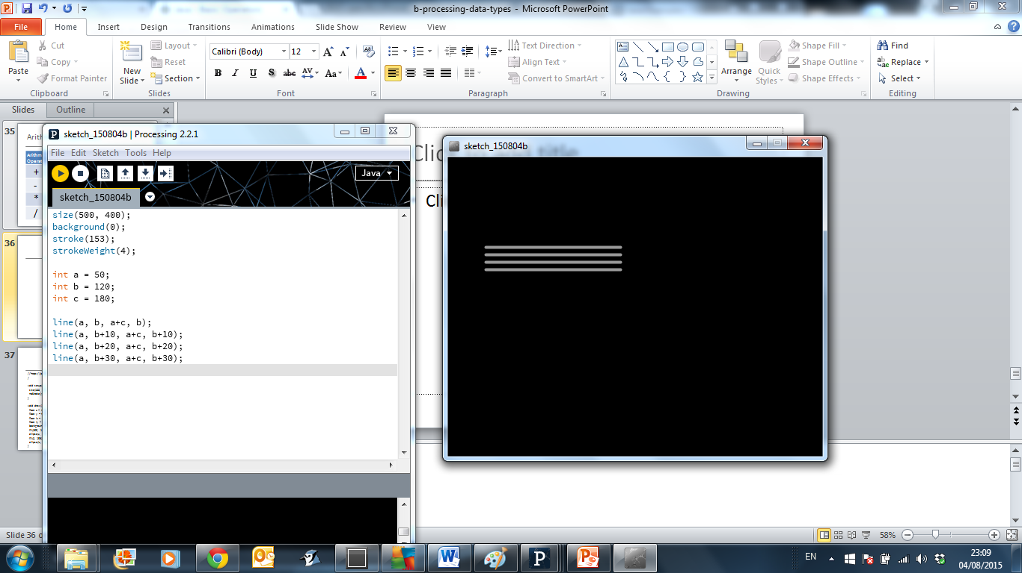
Arithmetic operators: Example 3.6
Based on the Processing Example: Basics → Data → Variables
Notes:
size(500, 400);
background(0);
stroke(153);
strokeWeight(4);
int a = 50;
int b = 120;
int c = 180;
line(a, b, a+c, b);
line(a, b+10, a+c, b+10);
line(a, b+20, a+c, b+20);
line(a, b+30, a+c, b+30);

Slide 36
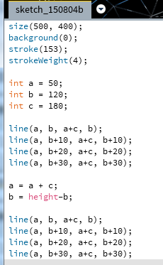
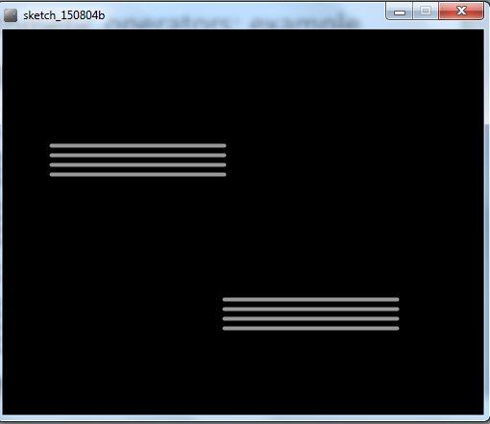
Arithmetic operators: Example 3.7
Based on the Processing Example: Basics → Data → Variables
Notes:
size(500, 400);
background(0);
stroke(153);
strokeWeight(4);
int a = 50;
int b = 120;
int c = 180;
line(a, b, a+c, b);
line(a, b+10, a+c, b+10);
line(a, b+20, a+c, b+20);
line(a, b+30, a+c, b+30);
a = a + c;
b = height-b;
line(a, b, a+c, b);
line(a, b+10, a+c, b+10);
line(a, b+20, a+c, b+20);
line(a, b+30, a+c, b+30);

Slide 37
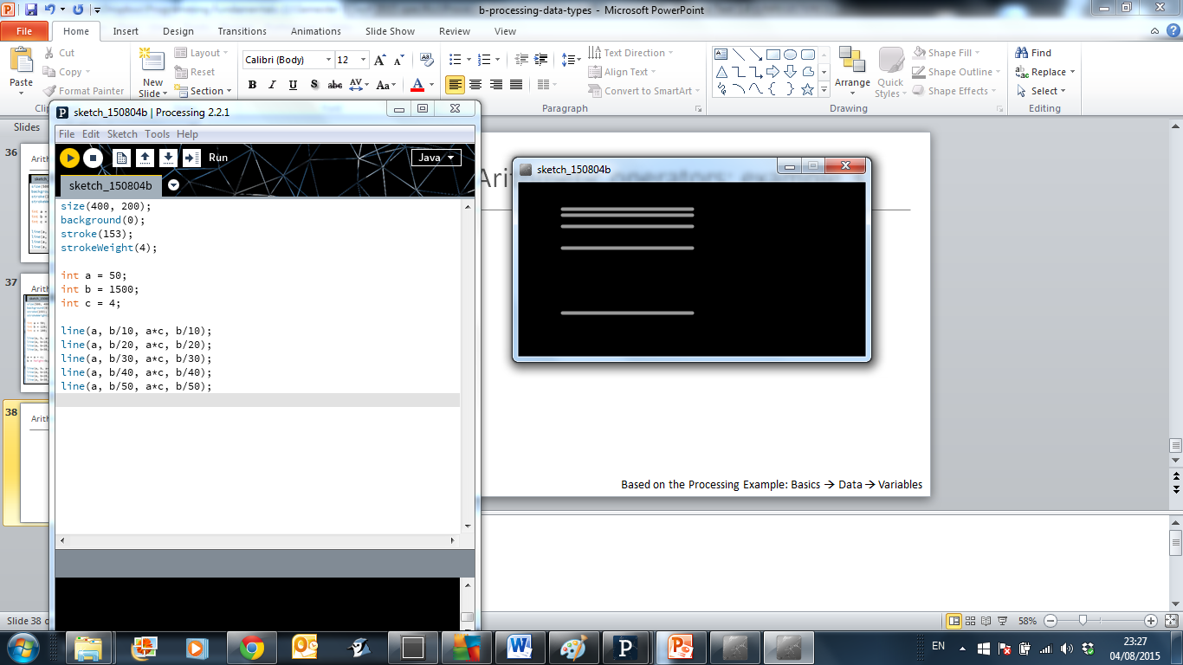
Arithmetic operators: Example 3.8
Based on the Processing Example: Basics → Data → Variables
Notes:
size(400, 200);
background(0);
stroke(153);
strokeWeight(4);
int a = 50;
int b = 1500;
int c = 4;
line(a, b/10, a*c, b/10);
line(a, b/20, a*c, b/20);
line(a, b/30, a*c, b/30);
line(a, b/40, a*c, b/40);
line(a, b/50, a*c, b/50);

Slide 38

Questions?

Slide 39
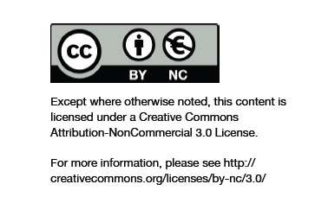
Department of Computing and Mathematics
http://www.wit.ie/

